Slide 1
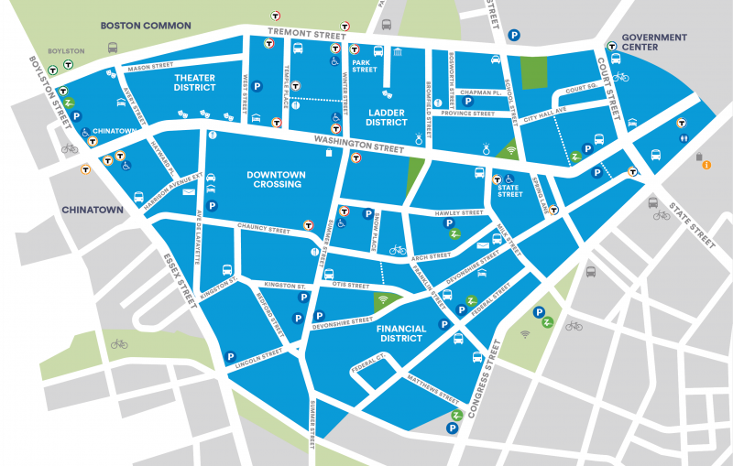

Slide 2
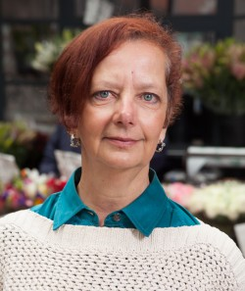
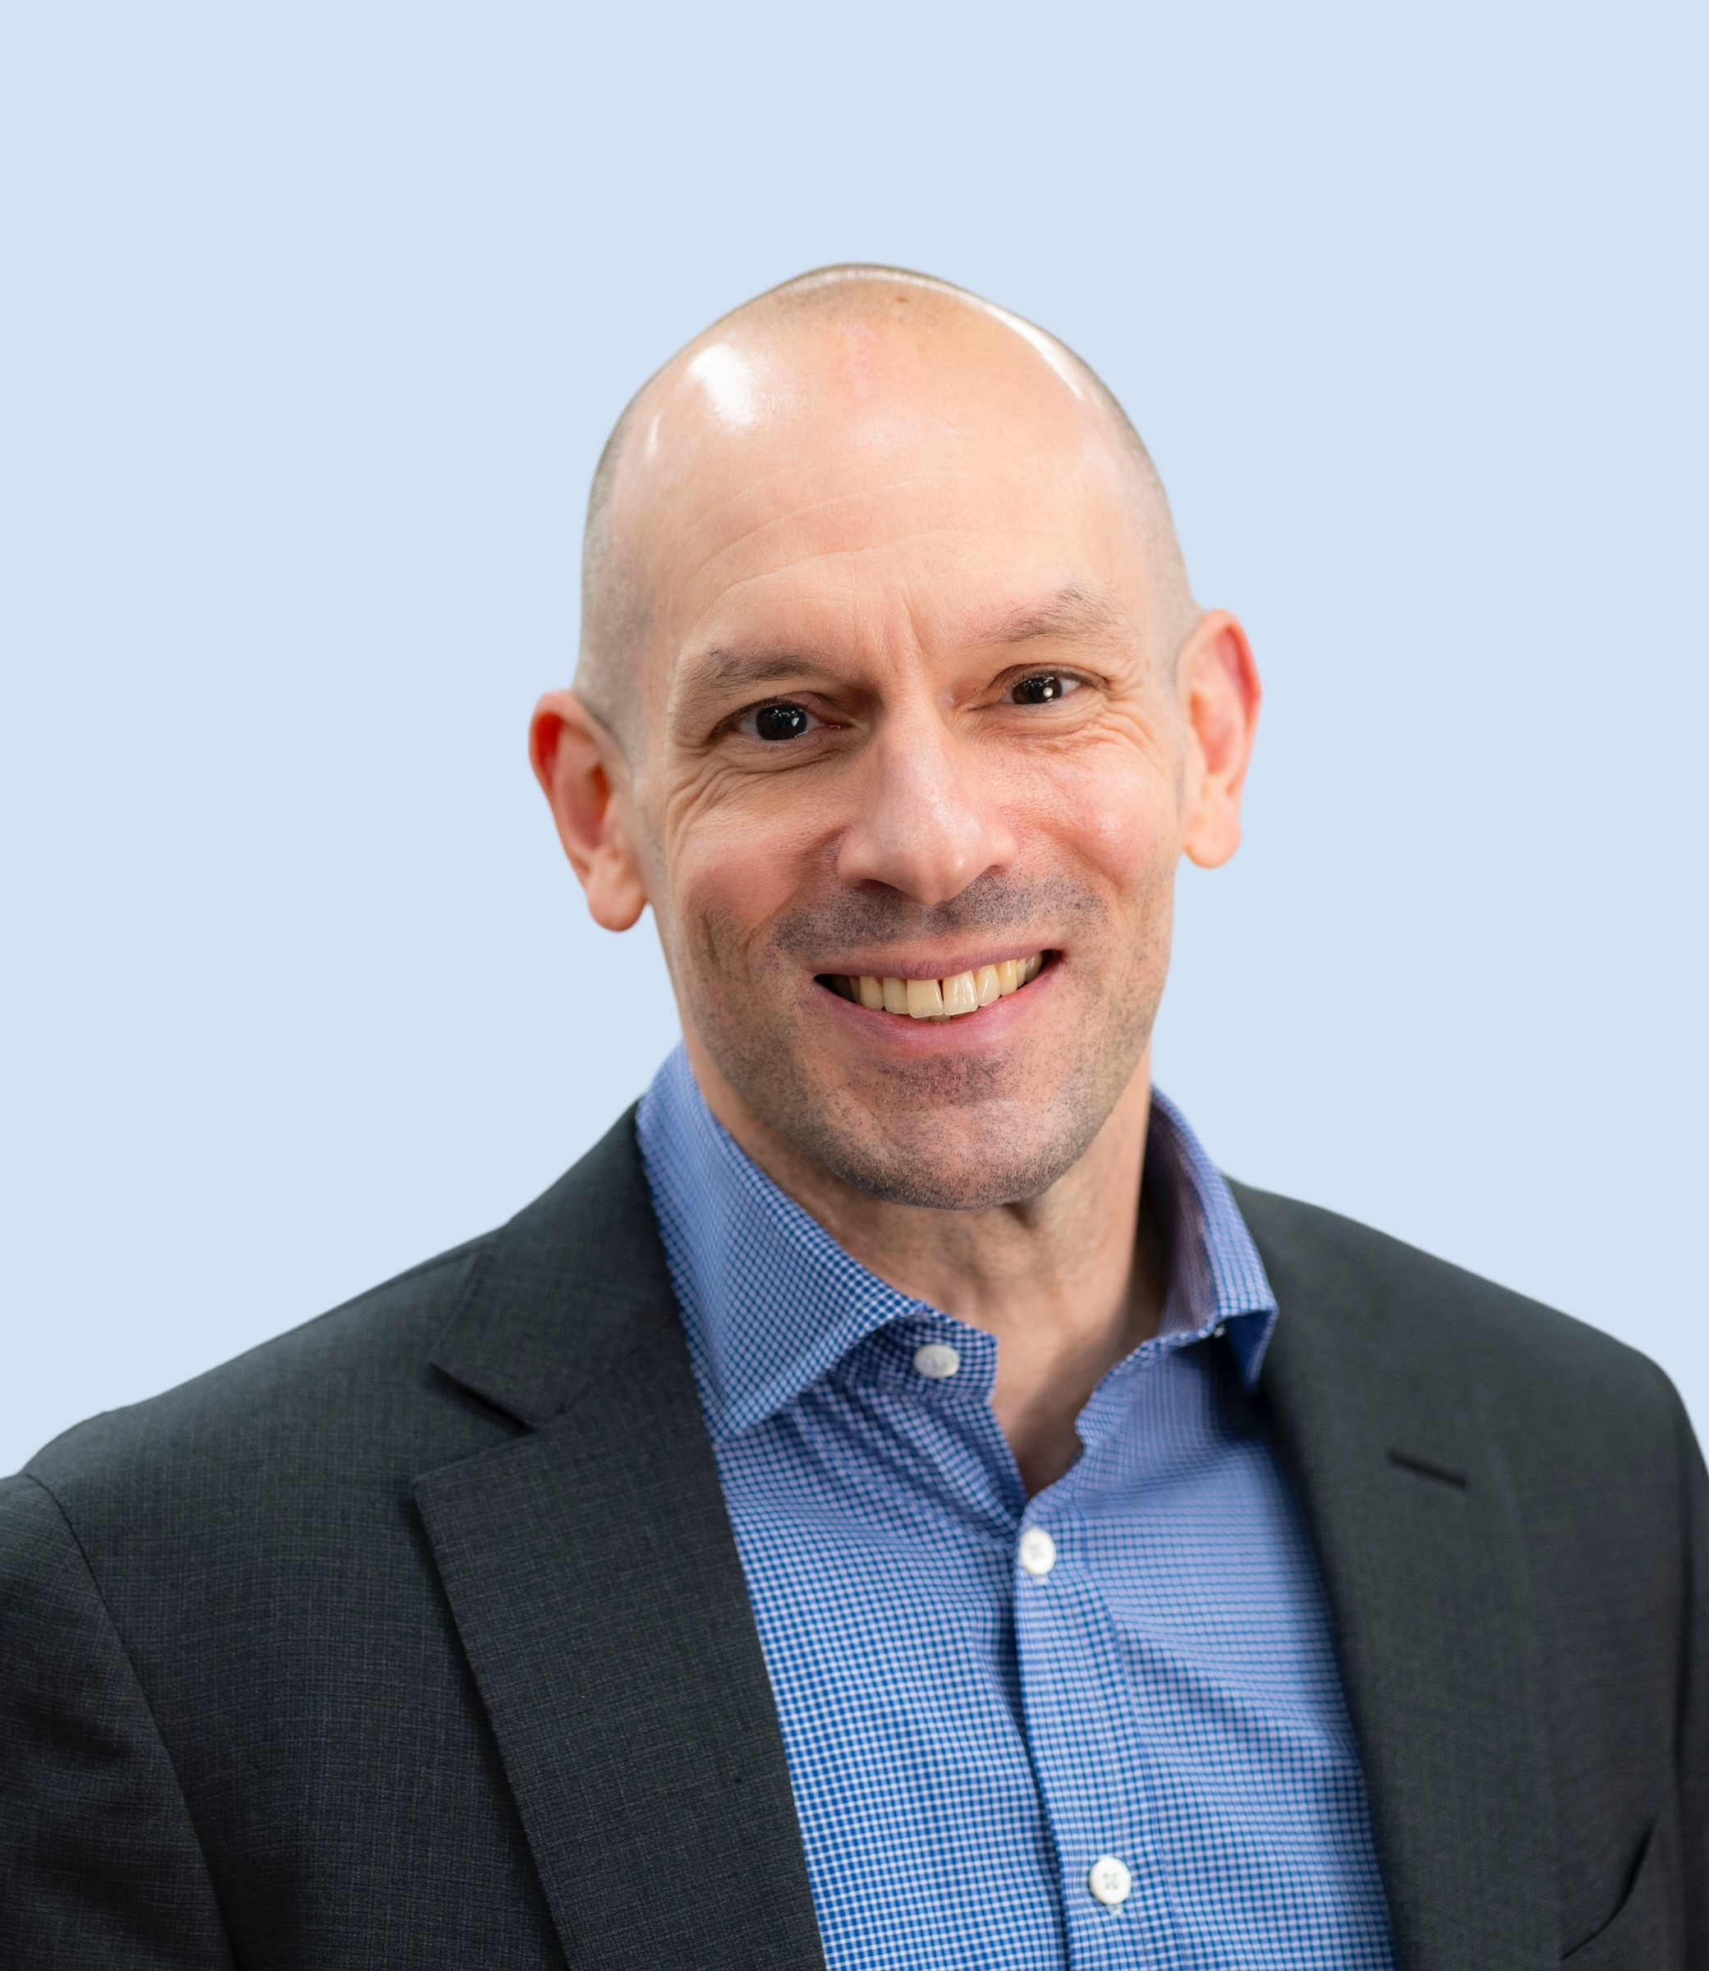
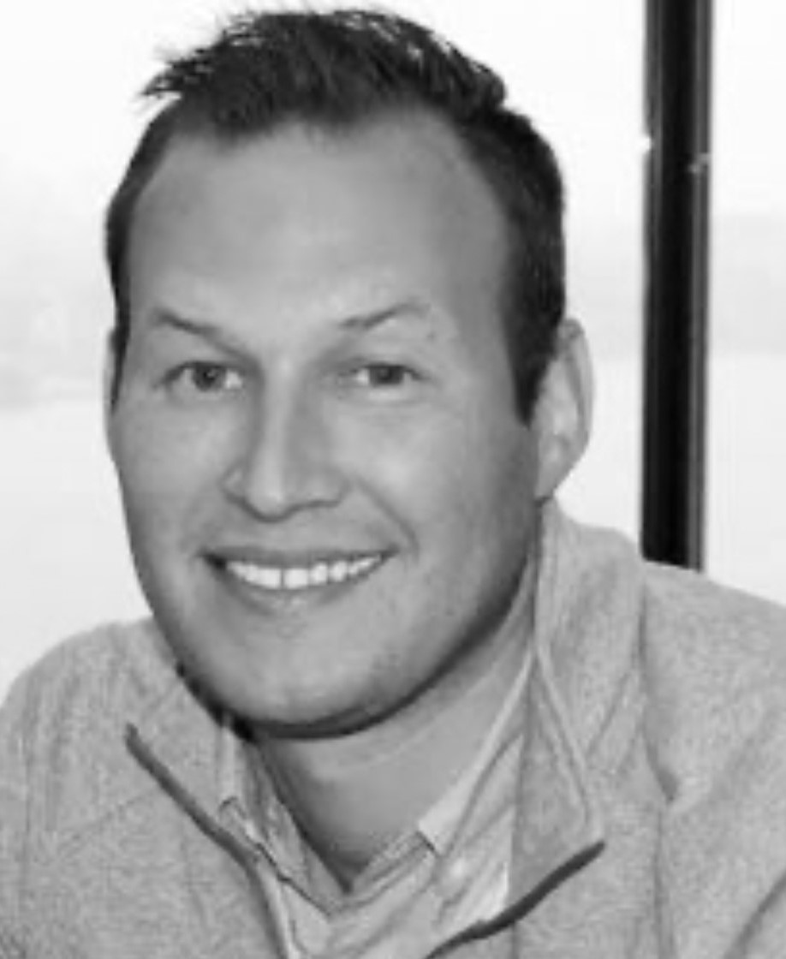
Breakfast Program
Wednesday, October 11, 2023
Panelists
Anita Lauricella
Director of Planning and Research
Boston Improvement District
John Weil
Senior Program Manager
Downtown Conversions
Morgan Weinstein
Executive Vice President
Phase 3 Real Estate Partners, Inc.

Slide 3
Anita Lauricella
Director of Planning & Research
Anita Lauricella joined the Downtown Boston BID in May of 2013. Anita's work includes overseeing that the BID's public realm meets the needs of members, residents, visitors, and is welcoming to everyone. Her prior work experience includes capital planning, public finance and tax policy at both the municipal and state levels. Anita is a board member of the Institute for Mindful Leadership. Her favorite part of her job at the BID is "walking around and finding new and fabulous, hidden gems."

Slide 4
John Weil
Senior Program Manager at BPDA
Focusing on office-to-residential conversions in the Central business District. With a background in Real Estate and a passion for innovation, He brings community- centered expertise. Outside of work, John’s rock climbing hobby mirrors his pursuit of challenges. He holds degrees from MIT and Bowdoin.

Slide 5
Morgan Weinstein
EVP at Phase 3 Real Estate Partners, Inc. has 15+ years of real estate experience socializing in Life Science sectors across the northeast, including Greater Boston. He manages acquisitions and leasing for the Boston portfolio, previously serving as Senior Director at BioMed Realty. He holds a degree in Management from the University of Delaware and a Massachusetts Real Estate Salesperson License.

Slide 6
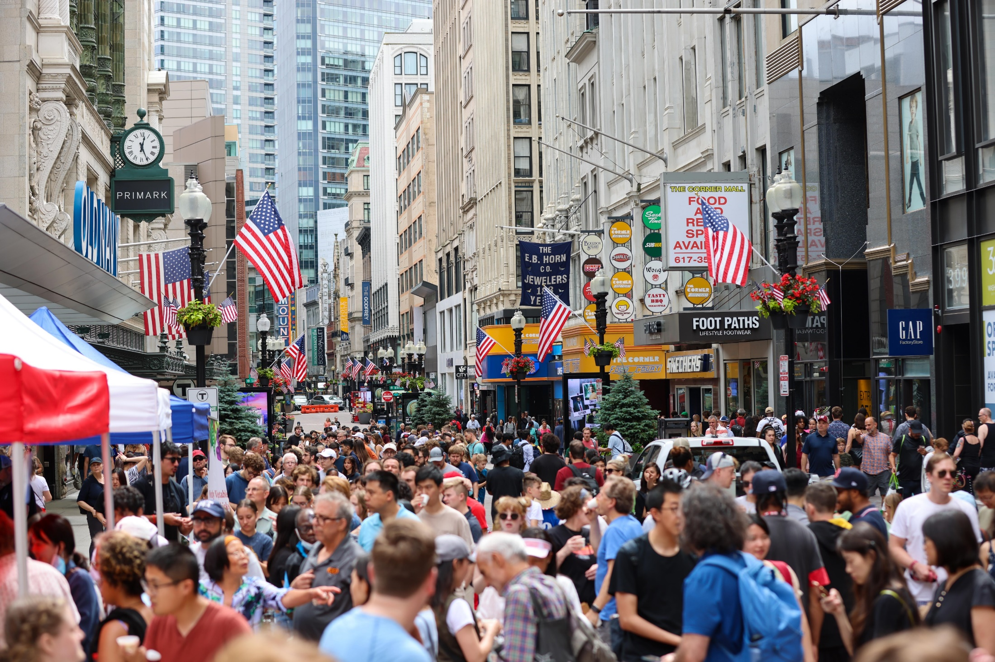

Slide 7
About the Downtown Boston BID
Masschusetts Building Congress – 11.16.2023

Slide 8
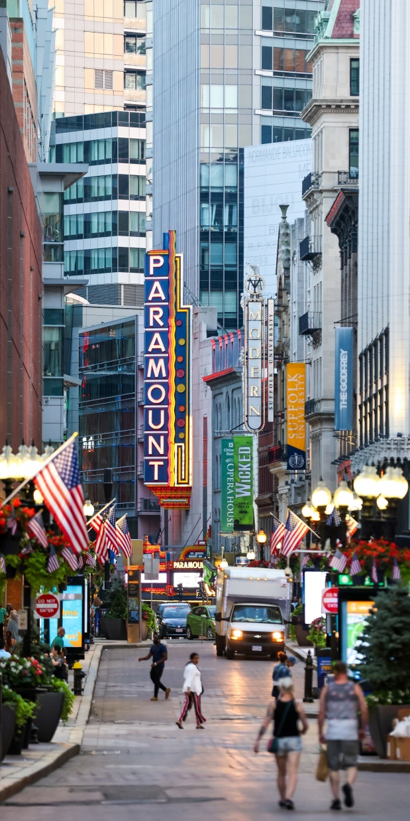
What is a Business Improvement District (BID)?

Slide 9
TRADITIONAL ROLES OF A BID
Supplemental City Services through Public/Private Partnership
Clean, Safe and Welcoming
Programming
Public Realm / Public Space Planning
Member Services
Marketing & Branding
Economic Development

Slide 10
Where is the Downtown Boston Business Improvement District (BID)?

Slide 11
DBBID:
Formed in 2011
180 bldgs
34 acres
Renewed three times
Neighborhoods with distinct identities:
Downtown Crossing
Financial District
Ladder Blocks
Theater District
Government Center

Slide 12
55 Summer Street Project

Slide 14
Boston Downtown Conversion Program
Office to Residential Adaptive Reuse
November 16, 2023

Slide 15
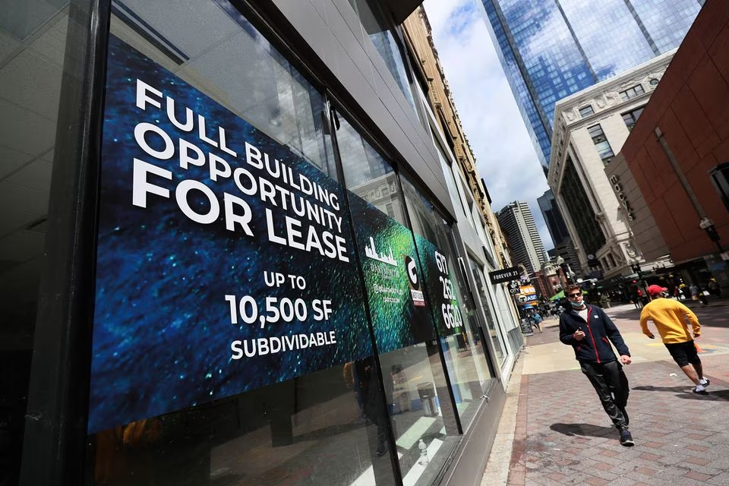
Why Convert Office to Residential
National Context
Downtown commercial buildings in most US cities have 20-30% vacancy
Half of tenants anticipate lease renewals with 50% sq ft reduction (survey of large commercial tenants)
Interest rates have doubled since many buildings were last financed
Upcoming refinancing needs as existing loans mature
Lenders pausing on most new commercial real estate loans

Slide 16
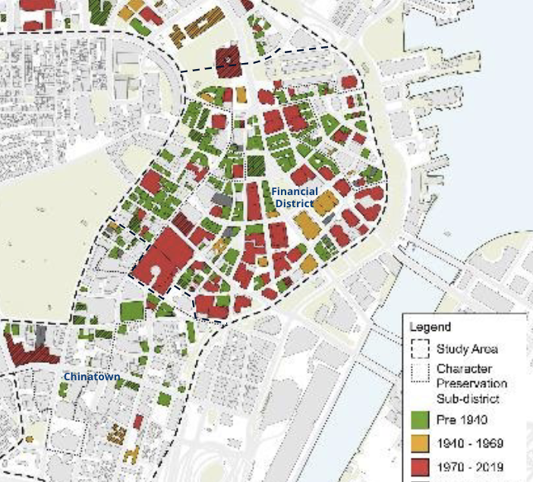
Why Convert Office to Residential Now
Boston Context
Boston downtown office vacancy ≈ 21% (vs. residential vacancy ≈ 4%)
CoStar projections rising to 30%
Average Boston office occupancy ≈ 60%
Employers are shifting to high amenity Class A buildings to woo workers back
Commonwealth expected to vacate 250k sq ft of leases in 2024
Class B & C office buildings most at risk (e.g. recently toured a well-maintained 100yr old building with 80% vacancy)

Slide 17
Boston Downtown Conversion Pilot
Key Elements
Program Benefits
Program Requirements
75% average residential tax abatement for 29 yrs
Fast-tracked Article 80 process (e.g. no IAGs, 1 community meeting)
As of Right zoning for use change
Streamlined permitting
Possible density bonus (pending approval of PLAN: Downtown)
Apply by June 2024
Fully permitted by Oct 2025
Meet BPDA approved Inclusionary Development Policy requirements
Comply with new “Stretch Code” green energy standards
Adaptive reuse only
2% Transaction charge
https://www.bostonplans.org/conversion

Slide 18
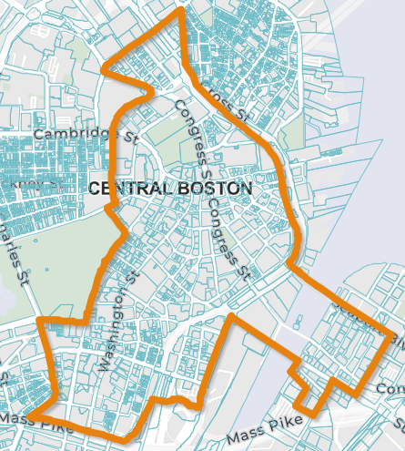
Tax Abatement Program
Demonstration Plan Area
Legal Mechanism
BPDA, City, and property owner will enter into a 121B PILOT agreement
To effectuate PILOT, BPDA will take a limited temporary interest in property
Projects within Demonstration Plan Area subject to streamlined 121B process
Projects outside of Demonstration Plan Area also receive consideration
Individual BPDA Board approval required for each project

Slide 19
Benefits to Boston
Revitalize Downtown
Respond to post-pandemic
lasting economic shifts
Application has been live for 1 month
Received first application submission
Top 6 list of potential applicants
Mostly within Demonstration Plan Area, however some outside
Range of project sizes (e.g. 15 unit / 6 stories and 150 unit / 11 stories)
Variety of participant profiles from office owners to potential acquirers
Continue outreach to property owners
Activate properties currently facing high office vacancies
Create an active Downtown beyond work hours
Build much-needed housing, including affordable rental

Slide 20
Additional Resources Being Explored
Exploring potential State funding sources to facilitate conversions
Potential grants in proposed Housing Bond Bill
Additional Federal resources under consideration to address national need to incentivize office to residential conversions
TIFIA (transit-oriented development) program low-interest loans
BPDA Senior Program Manager for Downtown Conversions to support applicants and potential candidates
BPDA Ombudsperson to guide through permitting process

Slide 21
2023 Officers & Directors
Officers
President | Fran Harrison, SMRT Architects/Engineers
Vice-President | Dan Wilson, Illuminate
Treasurer | Robert Boyle, CPA, Darmody, Merlino & Co., LLP
Board of Directors
Matthew Guarracino | JM Electrical Company, Inc.
Michael P. Sams | Kenney & Sams, P.C.
Rocco Derrigo | American Energy Management
Dan Perruzzi, AIA | Margulies Perruzzi Architects
Kenneth White | Walsh Brothers
Richard Lampman | Berkeley Building Company
Mary Vogel | Building Pathways
Executive Committee
Immediate Past President Jay Moskowitz City Point Partners
Chairman, Finance Committee Robert Boyle, CPA Darmody, Merlino & Co.
Ex-officio Executive Director Michelle Hopson Massachusetts Building Congress

Slide 22
Upcoming Events
MBC Holiday Breakfast for a Cause November 30, 2023 7:30 AM to 9:30 PM
Breakfast Program – To Update

